Slide 1
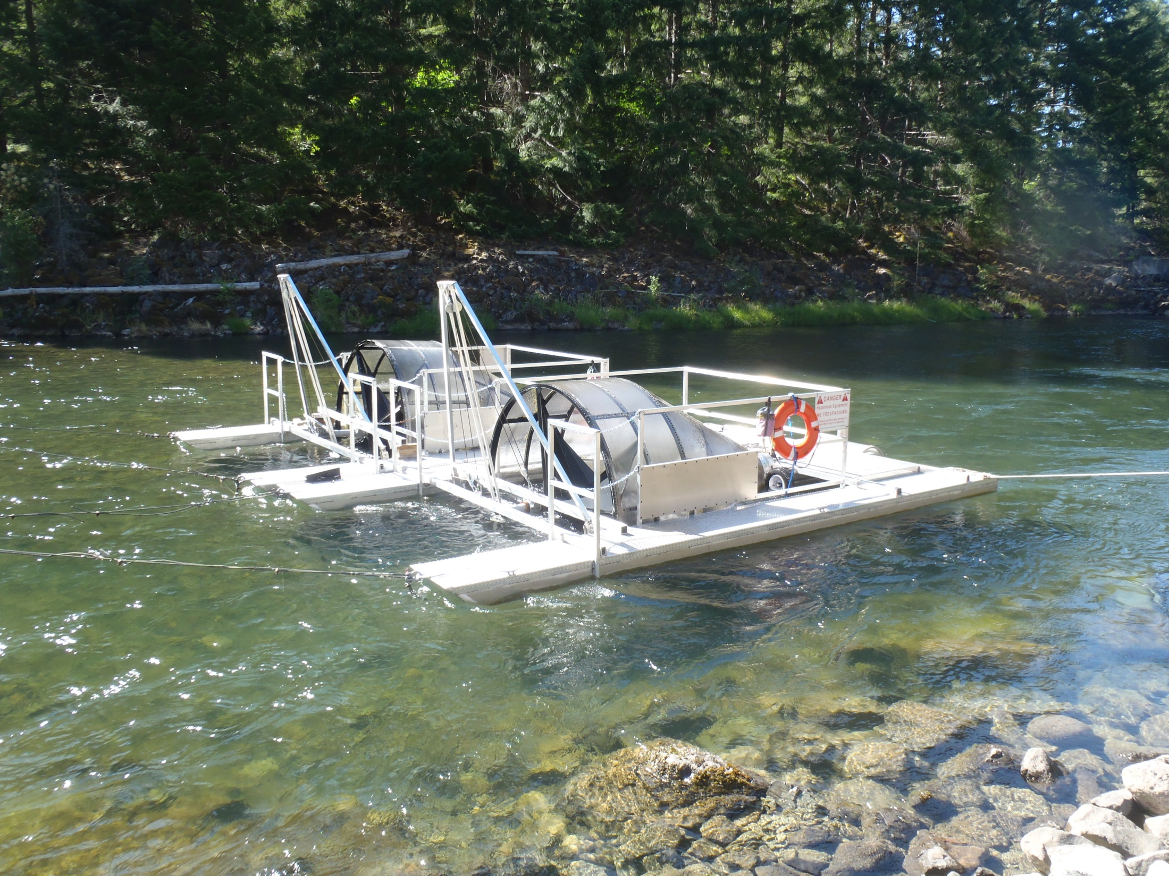


Migration timing and size of juvenile salmonids above and below Willamette Valley Project dams.
Jeremy D. Romer*
Fred R. Monzyk
Ryan Emig
Oregon Department of Fish and Wildlife
Corvallis Research Lab
jeremy.romer2@oregonstate.edu
Notes:
For those of you who don’t already know, our project operates screw traps above and below several reservoirs in the upper Willamette basin.

Slide 2
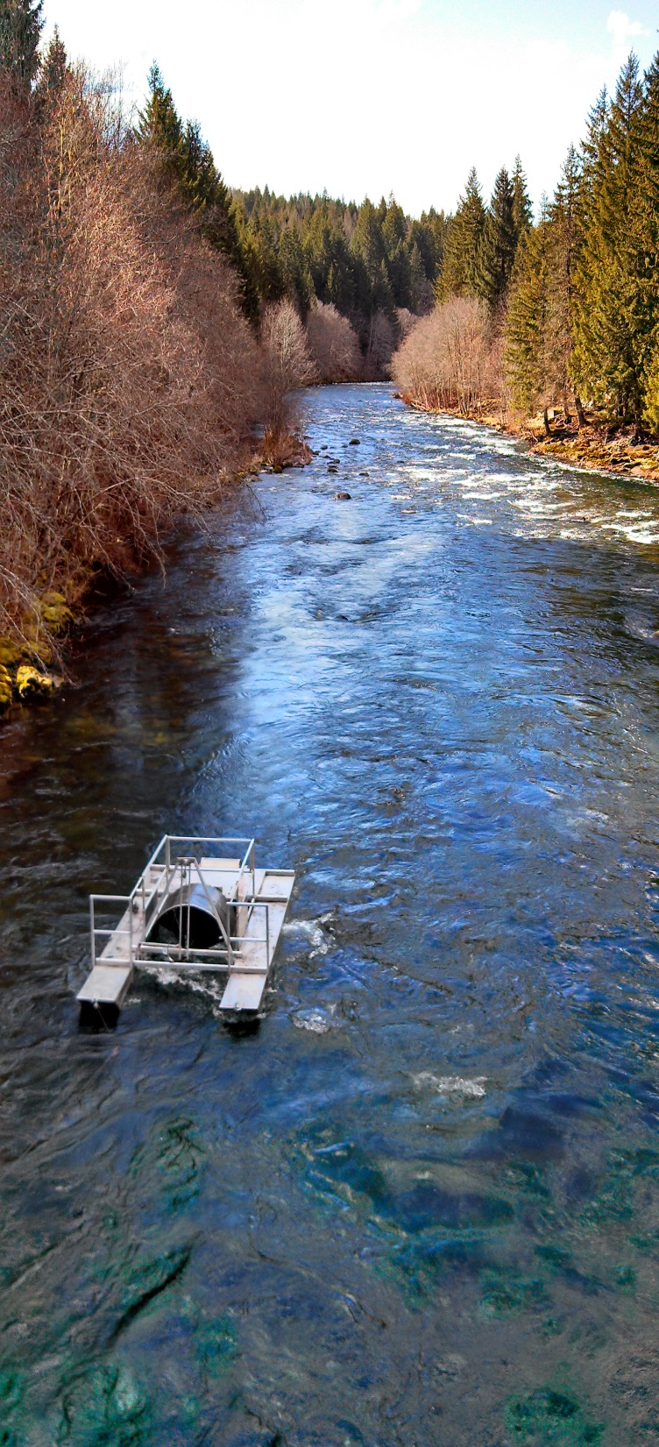
Objectives
Annual monitoring
Migration timing
Temporal size of migrants
Migrant abundance estimates
Long-term monitoring
Comparisons of migration timing, size, abundance
estimates among years
Estimate the number of adults needed to fully seed
available spawning habitat
Estimate survival of a cohort through the Cougar Project
Photo: Greg Gilham
Notes:
Our annual operations are focused on monitoring –
This information is necessary to
help develop downstream passage for juvenile salmonids and
evaluate the overall success of the adult outplanting program.
As we compile a larger dataset we can begin to address larger questions –

Slide 3
South Fork McKenzie River above Cougar Reservoir 2014
91%
Notes:
Here is an example of our typical yearly catch information from the S.Fk.McKenzie River upstream of Cougar Reservoir, with the date on the x-axis and fork length of juvenile Chinook on the y-axis.
We collected 11,400 Chinook in our trap.
Very few yearlings
91% of the fish we captured entered the reservoir as fry (<60 mm) in the spring (Mar-May).

Slide 4
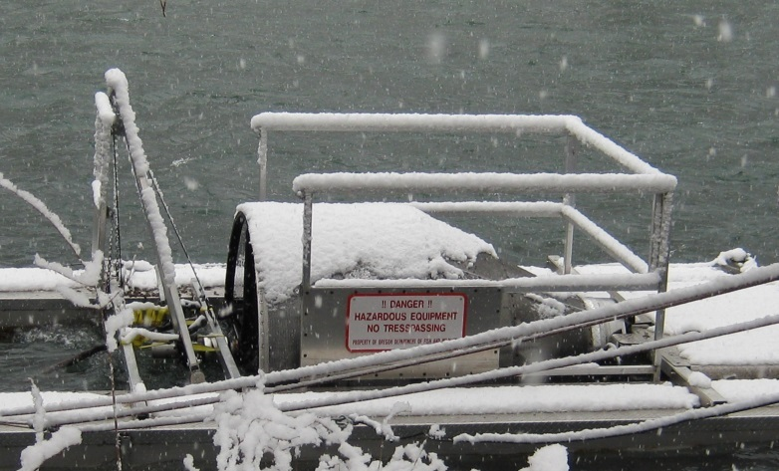
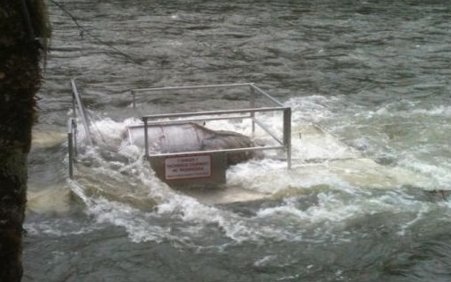
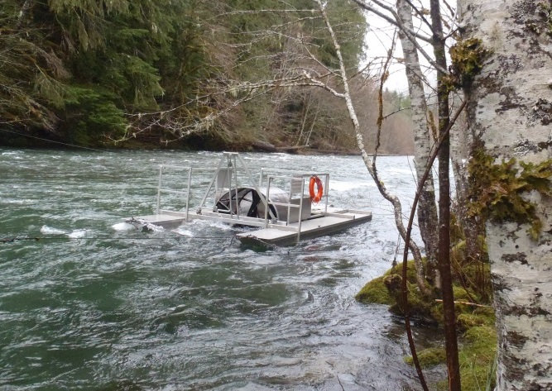
Median migration dates for juvenile spring Chinook upstream of WVP projects
Location | Year
 | 2010 | 2011 | 2012 | 2013 | 2014
North Santiam | -- | May 6 | May 14 | May 14 | May 8
Breitenbush | -- | Mar 8 | -- | -- | --
South Santiam | -- | -- | Mar 7 | Feb 28 | --ª
South Fork McKenzie | May 1 | May 16 | May 16 | Apr 26 | May 8
Middle Fork Willamette | -- | Mar 28 | Apr 13 | Apr 4 | Apr 9
ª Trap was not running for a 26 day window during what has been the peak of outmigration in previous years.
Notes:
As we compile additional years of data we can begin to see similarities and differences among basins and between years within the same basin. In this table we have the median migration dates for juvenile Chinook upstream of WVP projects.
You can think of the median date as the mid-point of the outmigration (the point at which half of the total number of fish collected in the trap throughout the year have been captured). Here you can see that:
Timing for the North Santiam and South Fork McKenzie are similar, and consistent among years.
That the Breitenbush (even though there is only one year of data), the South Santiam, and the Middle Fork Willamette are similar
And roughly 2 months earlier that the N.Santiam and S. Fk. Mckenzie.

Slide 5
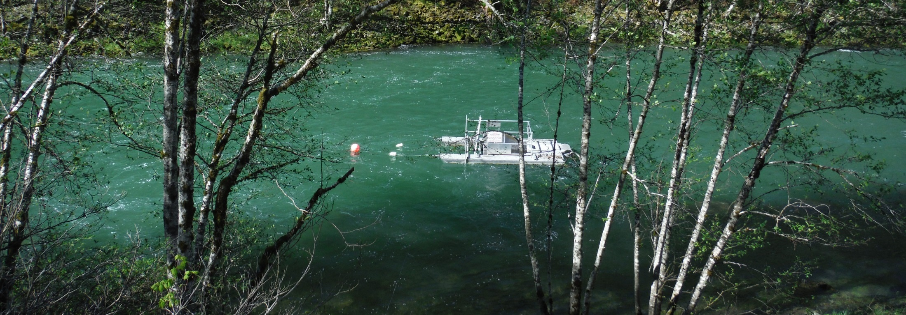
South Fork McKenzie River migrant estimates
Brood Year (BY) | Migrant estimate | 95% CI | Number of BY females | Total Number of redds (peak) | Number of redds below trap
2009 | 685,723 | ±72,519 | 629 | 274 | < 5
2010 | 152,159 | ±26,665 | 320 | 190 | --
2011 | 228,241 | ±34,715 | 336 | 241 | 29
2012 | 557,526 | ±66,031 | 448 | 249 | 33
2013 | 413,515 | ±56,164 | 337 | 146ª | --^{b}
ª Storm event in fall 2013 near peak spawn decreased redd numbers by flattening redds (2013) brood year. ^{b} Redds below trap were not surveyed.
Notes:
These are the S.Fk.McKenzie migrant estimates for the past 5 years.
Currently the S.Fk.McK is the only sub-basin where we are able to estimate the number of migrants due to the trap efficiency, and number of subyearlings available for mark/recap TE estimates.
You can see that the migrant estimates are highly variable among years.

Slide 6
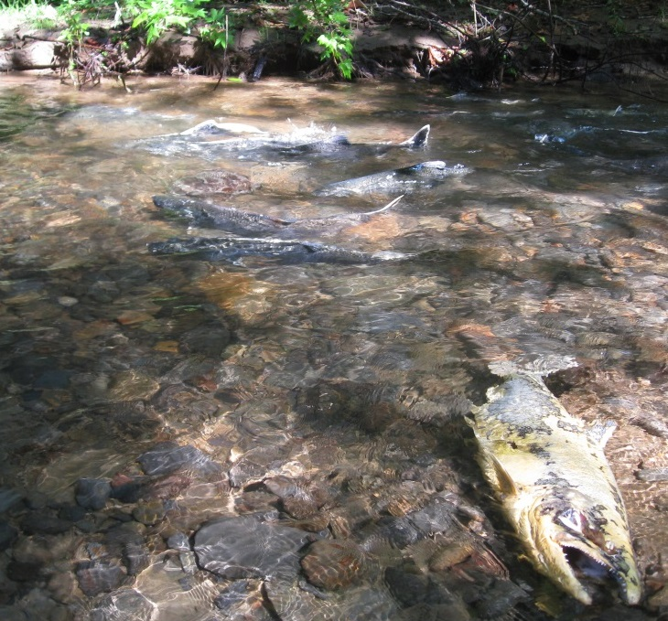
South Fork McKenzie River
Conceptual Exercise Alert
Can we estimate carrying capacity
for available spawning habitat?
Photo: ODFW OASIS Project
2013 BY
2009 BY
2012 BY
2011 BY
2010 BY
Notes:
Before we get started with this slide I would just like to clarify that this is a conceptual exercise.
So what we did here was take the same migrant estimates from the previous slide and plot them by the number of females transported upstream of Cougar Reservoir each year on the x-axis.
Then, we fit a natural log regression line through our current data set.
It should be noted that variations in estimates are subject to pre-spawn mortality and environmental conditions and this has not been corrected for.
Theoretically, as the regression line reaches an asymptote, the asymptote should correspond to the estimated number of females appropriate for the available spawning habitat.
Currently the 2009 BY point has high leverage and is essentially governing the shape of the curve.
We need to get several years of >500 females outplanted in this range to get a better representation of what is happening in the sub-basin.
*_a polynomial regression may be more appropriate, or a Beverton-Holt (Spawner recruitment function) but with this sparse dataset a natural log makes the most sense to me. If you fit a 3 or 4th order polynomial you are over-fitting your data and it doesn’t make ANY sense.
*_For the 2009 brood year they estimated a 62% pre-spawn mort rate which would leave us with 377 females.

Slide 7
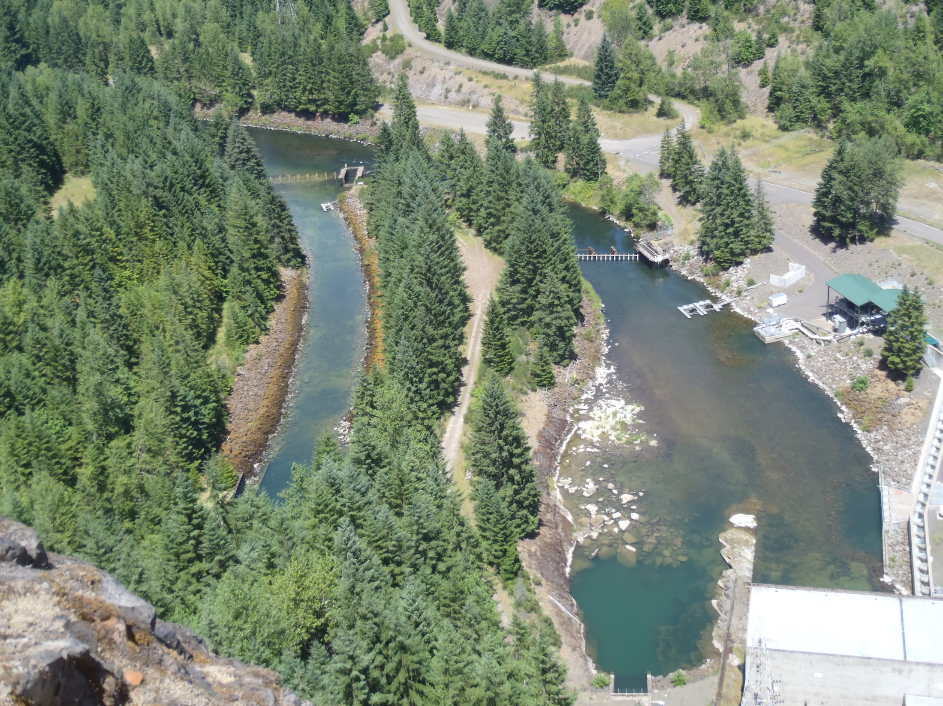
Below Cougar Dam
Regulating
Outlet
Turbine
Tailrace
Cougar Dam
Powerhouse
Notes:
Now we switch gears and move down below Cougar Dam. Our operation below the dam consists of a 5 ft trap located in the regulating outlet channel, and 2, 8 ft traps in the turbine tailrace.

Slide 8
South Fork McKenzie River below Cougar Dam 2014
Fork length of Juvenile Chinook (mm)
Date
Notes:
Here is an example of our typical yearly catch information from the S.Fk.McKenzie River below Cougar, with the date on the x-axis and fork length of juvenile Chinook on the y-axis.
You will notice that yearlings (red) primarily exit the dam during the spring and the subyearlings (blue) in the fall/winter.
In addition to the timing and size information, we are also able to provide other researchers with information about their fish. For instance, here we were able verify that the USSGS research fish effectively mimicked the size and timing of the naturally produced fish.

Slide 9
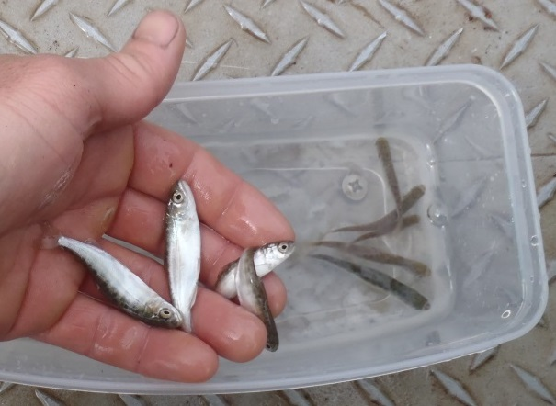
Comparison of migration timing and size above and below Cougar Dam
Tracking a brood year through time (22 months)
Fry
Feb-Jun
Mix
Sub
Sep-Dec
Yearling
Jan-Dec
Notes:
Essentially, it takes 2 years of data to describe how juvenile Chinook use the WVP projects.
You can think of the top and bottom panels as separate screw traps running simultaneously.
The blue bars represent the number of Chinook captured from the 2009 Brood Year (2010-2011 trapping data).
The x-axis is a 22-month scale consistent with the amount of time juvenile fish spend in the project.
The top panel is what is happening above Cougar Dam as fish are moving into the reservoir.
The bottom panel is what is happening below Cougar Dam.
The black line indicates the mean size of the fish for that month. Take the month of Sept for the 2009 BY for example. Fish entering the reservoir are ~70 mm, and fish from the same BY exiting the dam are ~100 mm on average.
These graphs illustrate the point that we try to convey in our reports, that a large majority of CHS enter as fry in the spring and exit the projects as subyearlings in the fall.

Slide 10
Migration timing is consistent under current operations
Strength of brood year is highly variable
Notes:
We have these graphs for all brood years, which show us a couple of things –
Migration timing is highly consistent among years under current operations
Strength of brood year is highly variable

Slide 11
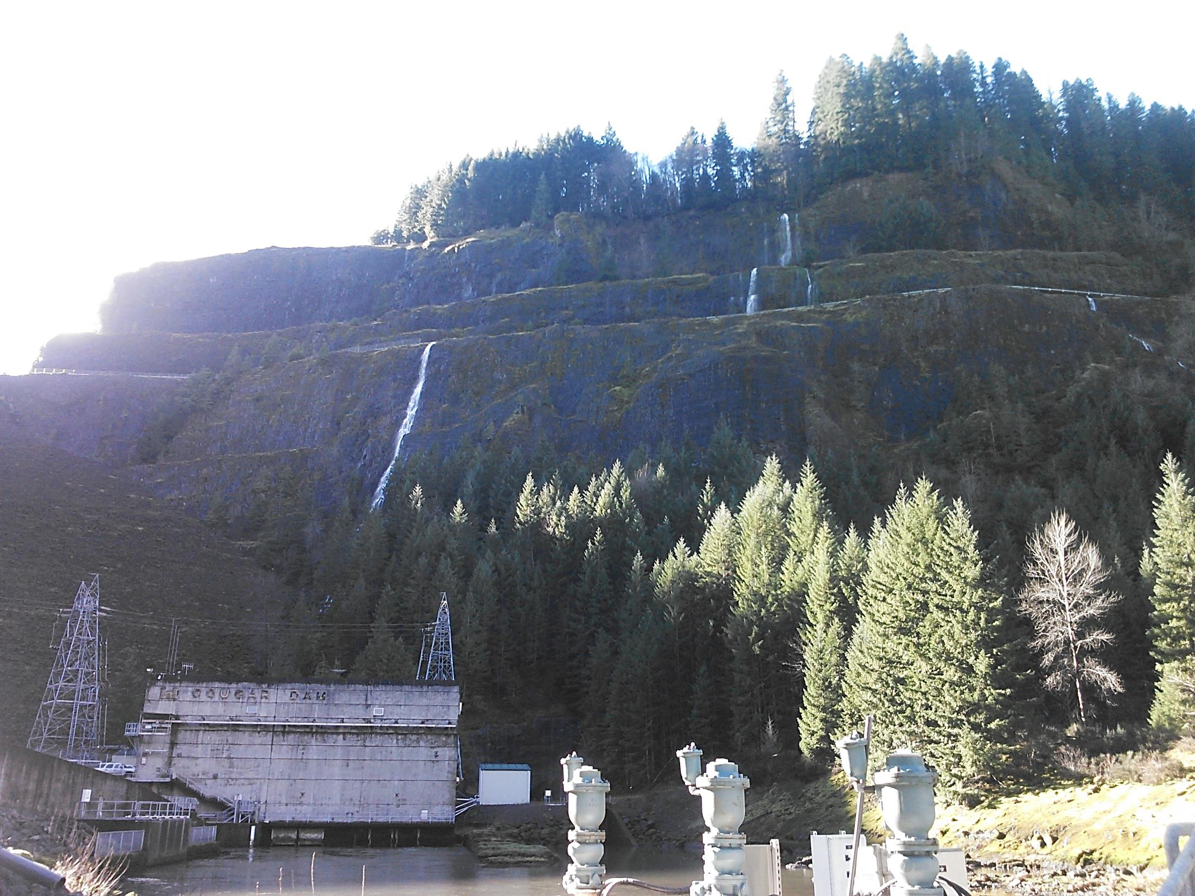
South Fork McKenzie River
We used the above and below dam migrant estimates from 2013 (2012 brood year) to estimate that ~17.5% (11.6 – 25.0%) of the Chinook salmon that entered Cougar Reservoir survived to below Cougar Dam.
Notes:
We used the above and below dam migrant estimates from 2013 (2012 brood year) to estimate that ~17.5% (11.6 – 25.0%) of the Chinook salmon that entered Cougar Reservoir survived to below Cougar Dam.
SLAM / VSP model states that ~20% (15-35%) will survive from the trap TO the dam. This suggests that the ‘reservoir survival’ might be higher than 20% at Cougar Reservoir.

Slide 12
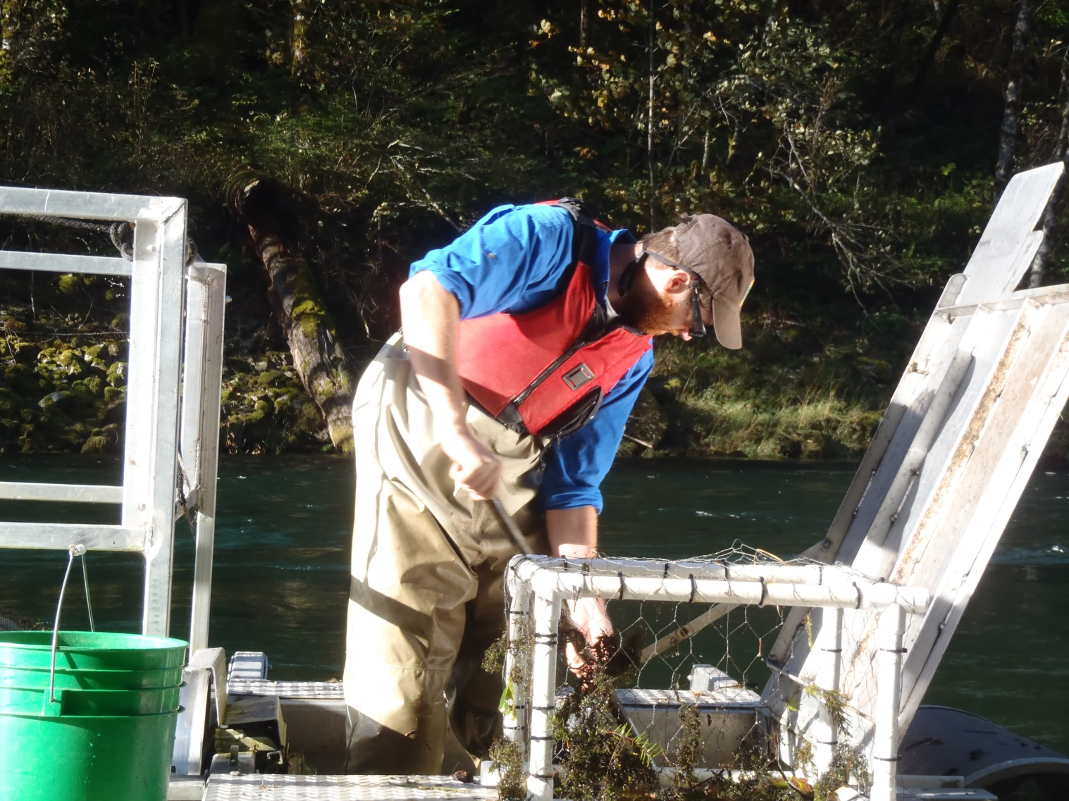
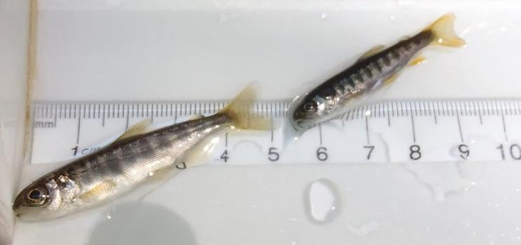
South Santiam River above Foster Reservoir
Chinook
O.mykiss
Notes:
Now we switch gears, and basins. The South Santiam River is currently the only river in the upper Willamette where adult winter steelhead and spring Chinook are transported above the project.

Slide 13
South Santiam River O.mykiss
2012
2013
Number of juvenile O.mykiss captured
Mean weekly discharge (ft³/s)
2014
Notes:
This graph shows the age class (legend) and number of O.mykiss captured (colored bars, Left Y-axis) with the date displayed on the x-axis for 3 sampling years.
The yellow line is the mean weekly discharge (right Y-axis), and the red line indicates the flow at which we are unable to sample.
2012 was a typical trapping season, where we captured a few fish prior to mid-June with a good portion of the spring not conducive for screw trapping operations. We were able to get some sampling in but it was pretty touch-and-go .
2013 was a relatively low flow year and we were able to capture some of the age-1 and age-2 fish during what we would expect to be consistent with the peak of the steelhead smolt outmigration.
2014 was COMPLETELY different. We didn’t capture any fish in the spring, and even captured very few of the steelhead fry we expected to emerge in mid-June. Then, with the first small freshet in the end of October we were swamped with fish.
We have a couple of theories - Did high flows in mid Feb and Mar 2014 allow more access to upper tributaries for spawning adults ?
Was it that the stream flows were so low from June onward that that juveniles spawned in the upper tributaries were stuck in pools in and could not get out until the freshets in Oct ?
These types of anomalies are good examples of why long term monitoring is important.

Slide 14
Summary
Juvenile Chinook above and below WVP dams
In all sub-basins and years we sampled, a majority of Chinook enter reservoirs
as fry (<60 mm) in the spring and exit as subyearlings in fall.
Migration timing is similar in Middle Fork Willamette and South Santiam rivers,
but earlier than North Santiam and South Fork McKenzie.
As more data are collected, migrant abundance estimates may be used to estimate
carrying capacity of spawning habitat above Cougar Reservoir.
Migrant estimates between consecutive years can be highly variable.
Above and below dam screw trapping can be used to estimate survival
through projects where sufficient data are available.
Juvenile O.mykiss in the South Santiam River
Emergence timing in the South Santiam is consistent among years.
Migration timing for different age classes into Foster Reservoir is highly variable
among years.

Slide 15

Acknowledgments
Doug Garletts
Chad Helms
Greg Taylor
Rich Piaskowski
Jeff Ziller
Khoury Hickman
Chris Abbes
Greg Gilham
Meghan Horne-Brine
John Elliot
Kevin Stertz
Andrew Nordick
Mario Minder
Ryan Flaherty
JD Hansen
http://oregonstate.edu/dept/ODFW/willamettesalmonidrme/reservoir-research

Slide 16
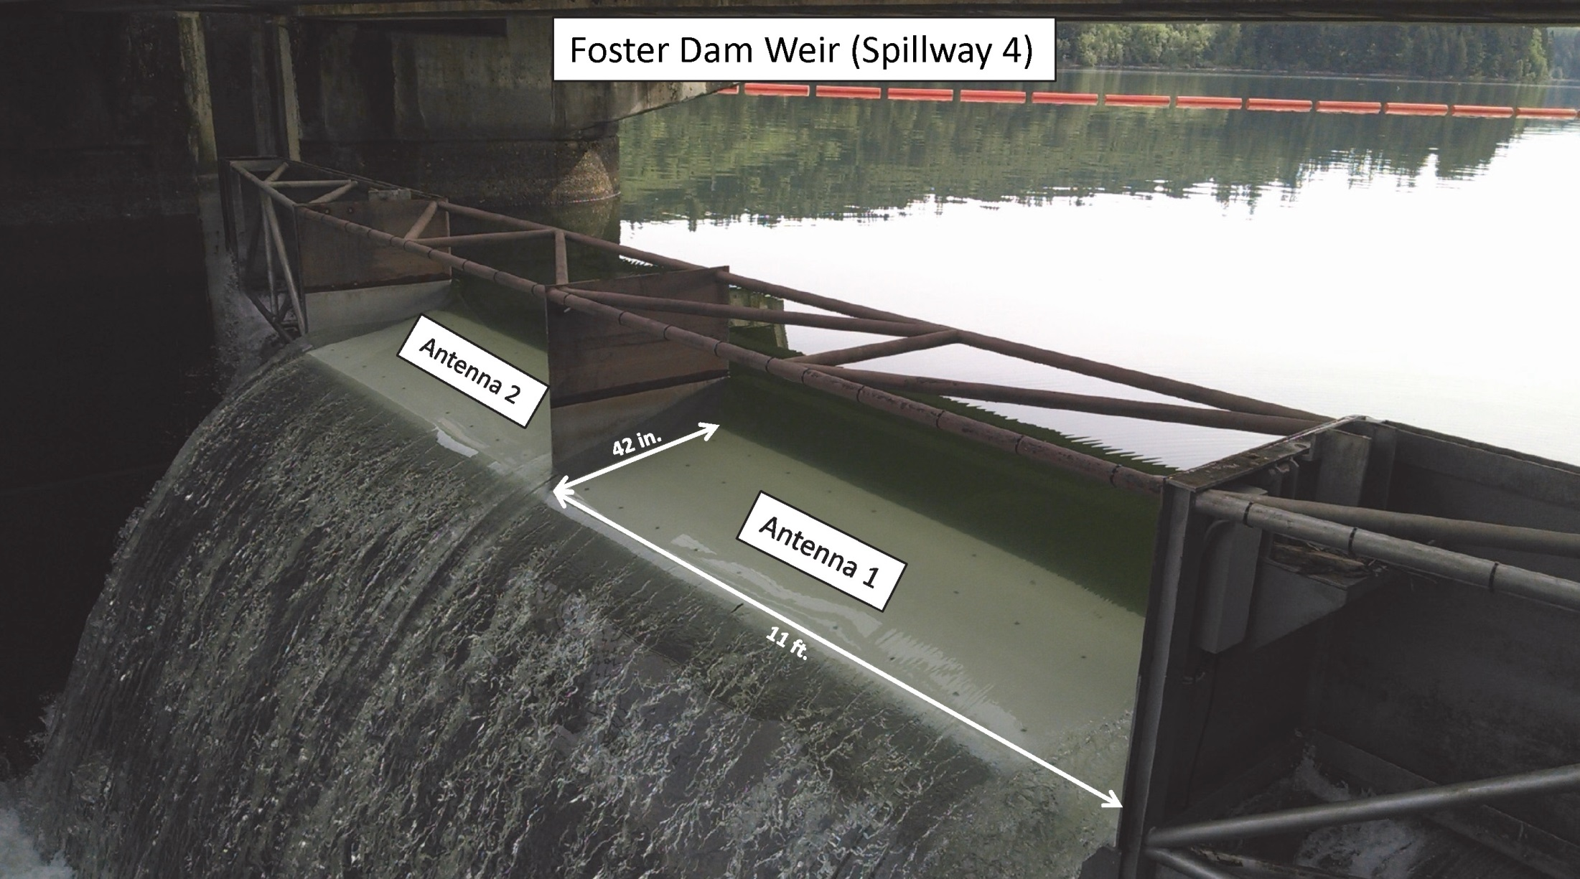

Slide 17
South Santiam – Foster Dam weir antenna
Expected peak of smolt migration
O. mykiss detections
14 - 2 yr old (presumably smolts)
4 - 1 yr old

Slide 18
South Fork McKenzie River
2009 BY
2013 BY
2012 BY
2011 BY
2010 BY
Notes:
These are the same migrant estimates plotted by the number of juvenile CHS captured for each of those years.
The S.Fk.McK is a stable trapping site.
You would expect the R factor to be high for this correlation. Sources of variation (deviation from the line) include changes in annual survival and our ability to run the trap due to environmental conditions.
On a river like the N. Santiam where we have not had enough fish to mark and get trap efficiencies in the past, we may be able to estimate some abundance for past years if we can generate a similar graph for the next few years.

